Slide 1
American Sign Language Detection
Using SVM, ultralytics yolov5, and CNN

Slide 2
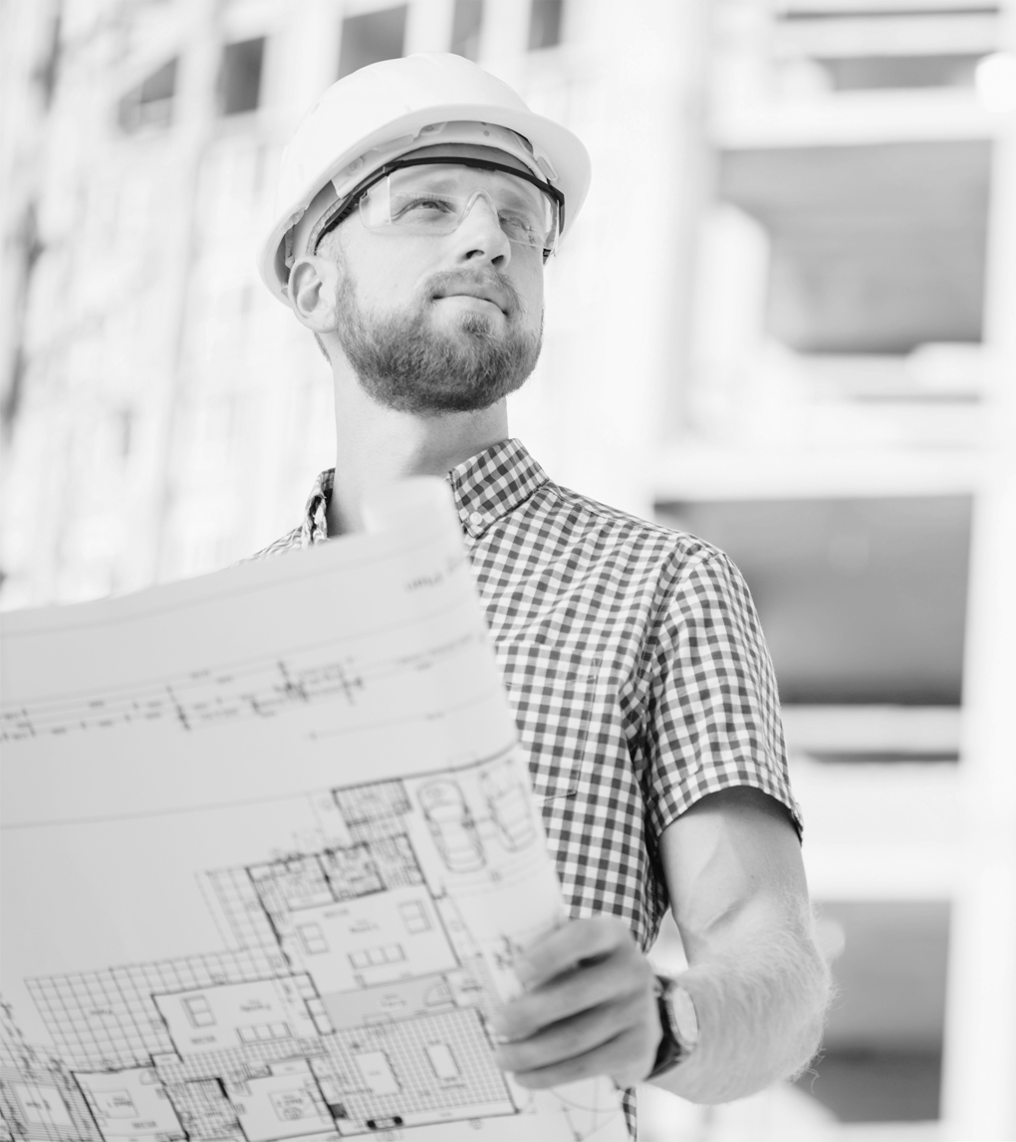
Our Team
Ahmed Mostafa
Implementing and maintaining CNN and Yolov5 models
Ali Ayman
Implementing and maintaining the SVM model
Supervised:
Dr. Wael Badawy
Eng. Aya Adel

Slide 3
About the Project
01.
First model
Major Requirements
04.
02.
Second model
Project Goals
05.
03.
Third model
06.
What is ASL
The support vector machine
The dataset and required packages
The ultralytics/yolov5
What do we tend to Project Stages?
The convolutional neural network
Comparing the results
07.

Slide 4
01
About the Project
What is ASL

Slide 5
What is ASL
Today, we delve into the realm of American Sign Language (ASL), not just as a
language of expression but as a fascinating challenge for deep learning.
ASL detection involves deciphering the intricate hand movements, facial
expressions, and body language that make up this unique communication
form. In the next few minutes, we'll explore the technical nuances of applying
deep learning models to detect and interpret ASL.
In this project, we'll leverage three powerful technologies — Support Vector
Machines (SVM), YOLOv5 (You Only Look Once), and Convolutional Neural
Networks (CNN) — to tackle the task of American Sign Language (ASL)
detection. Each approach brings its own strengths, and by comparing the
results, we aim to identify the most effective method for accurately recognizing
and interpreting ASL gestures.
Let's dive into the world where artificial intelligence meets the art of
sign language.

Slide 6
02
Major Requirements
The dataset
and required packages

Slide 7
Dataset & packages
Dataset:
For this project, we’ve used a comprehensive dataset of ASL gestures,
capturing a diverse range of signs. This dataset serves as the foundation for
training and evaluating our models, ensuring robust performance across
various gestures and expressions. You can find it here dataset , ASL
Packages Used:
Scikit-learn (SVM)
ultralytics YOLOv5
TensorFlow (CNN)
joblib
PIL
tensorflow.keras
pandas
Numpy
Torch
Cv2
matplotlib

Slide 8
03
Project Goals
What do we tend to Project Stages

Slide 9
Stages
Implement YOLOv5
Compare
Train & validate
Measure the loss & accuracy
1
3
Compare the loss, accuracy and other metrics
Implement SVM
Implement CNN
Train & validate
Measure the accuracy
2
Train & validate
Measure the loss & accuracy
4

Slide 10
04
First model
The support vector machine SVM

Slide 11
The support vector machine SVM
Support Vector Machines (SVM):
SVM is a powerful supervised machine learning algorithm used for
classification and regression tasks. Its primary objective is to find a hyperplane
that best separates data points belonging to different classes. In the context of
classification, SVM aims to create a decision boundary that maximizes the
margin between different classes, enhancing its generalization ability.
Metrices:
Accuracy: 78.61%

Slide 12
05
Second model
The ultralytics/yolov5

Slide 13
The ultralytics/yolov5
YOLOv5 (You Only Look Once):
YOLOv5 is a state-of-the-art object detection algorithm that belongs to the
YOLO family. The key innovation of YOLO is its real-time processing capability,
allowing it to detect and classify multiple objects within an image in a single
forward pass through the neural network. YOLOv5 improves upon its
predecessors by incorporating advancements in architecture, training
strategies, and performance.
First we convert our numerical dataset into images (YOLO format )
Second we do Annotation:
the process of adding metadata or labels to
images to provide additional information about specific objects
Then Train the YOLOv5 model: training process on our dataset.

Slide 14
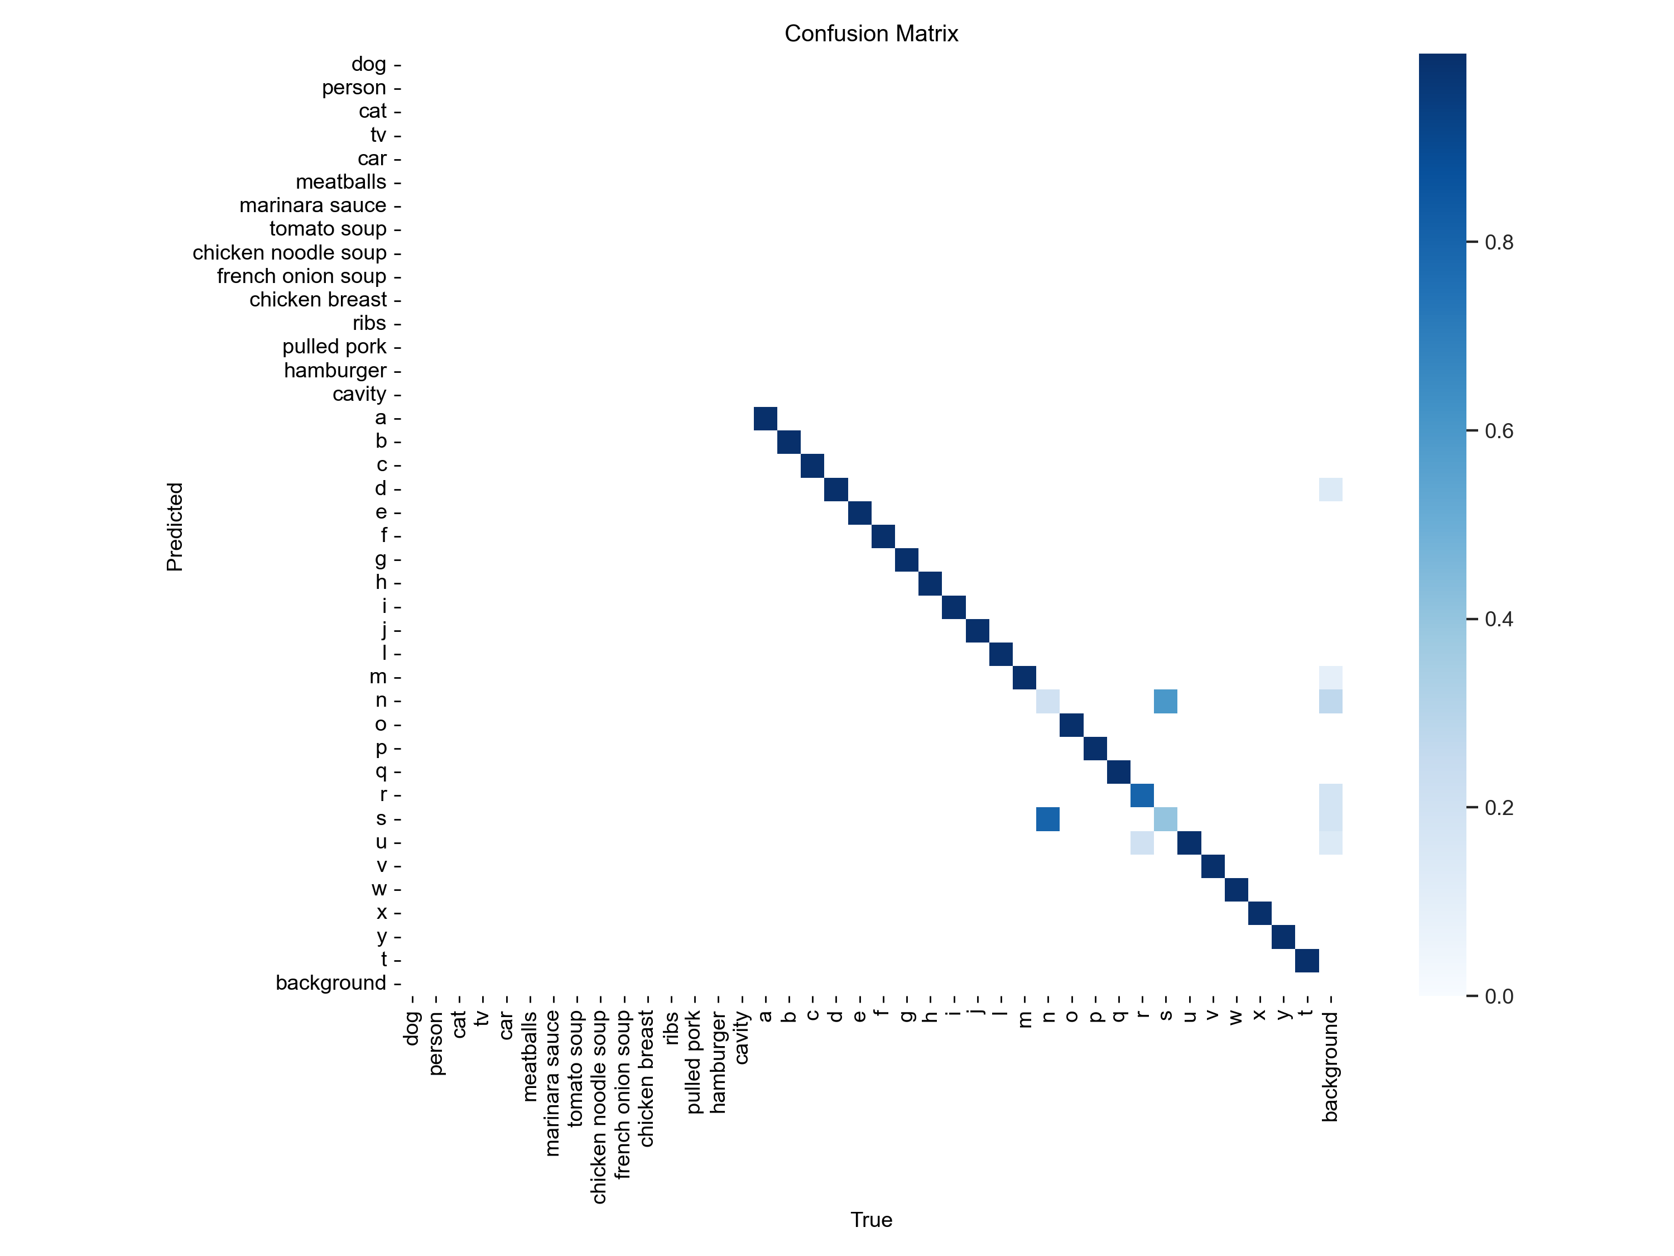
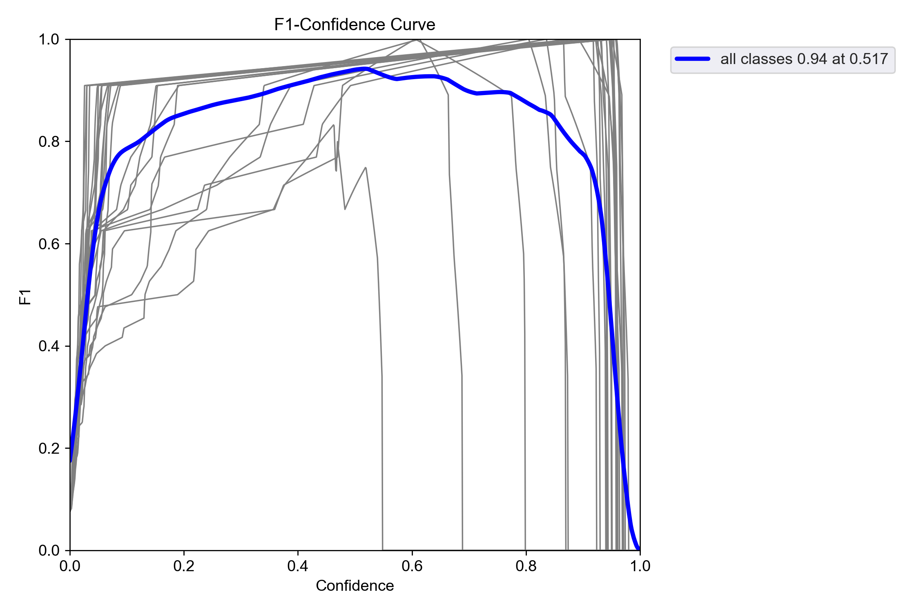
Validate & metrics

Slide 15
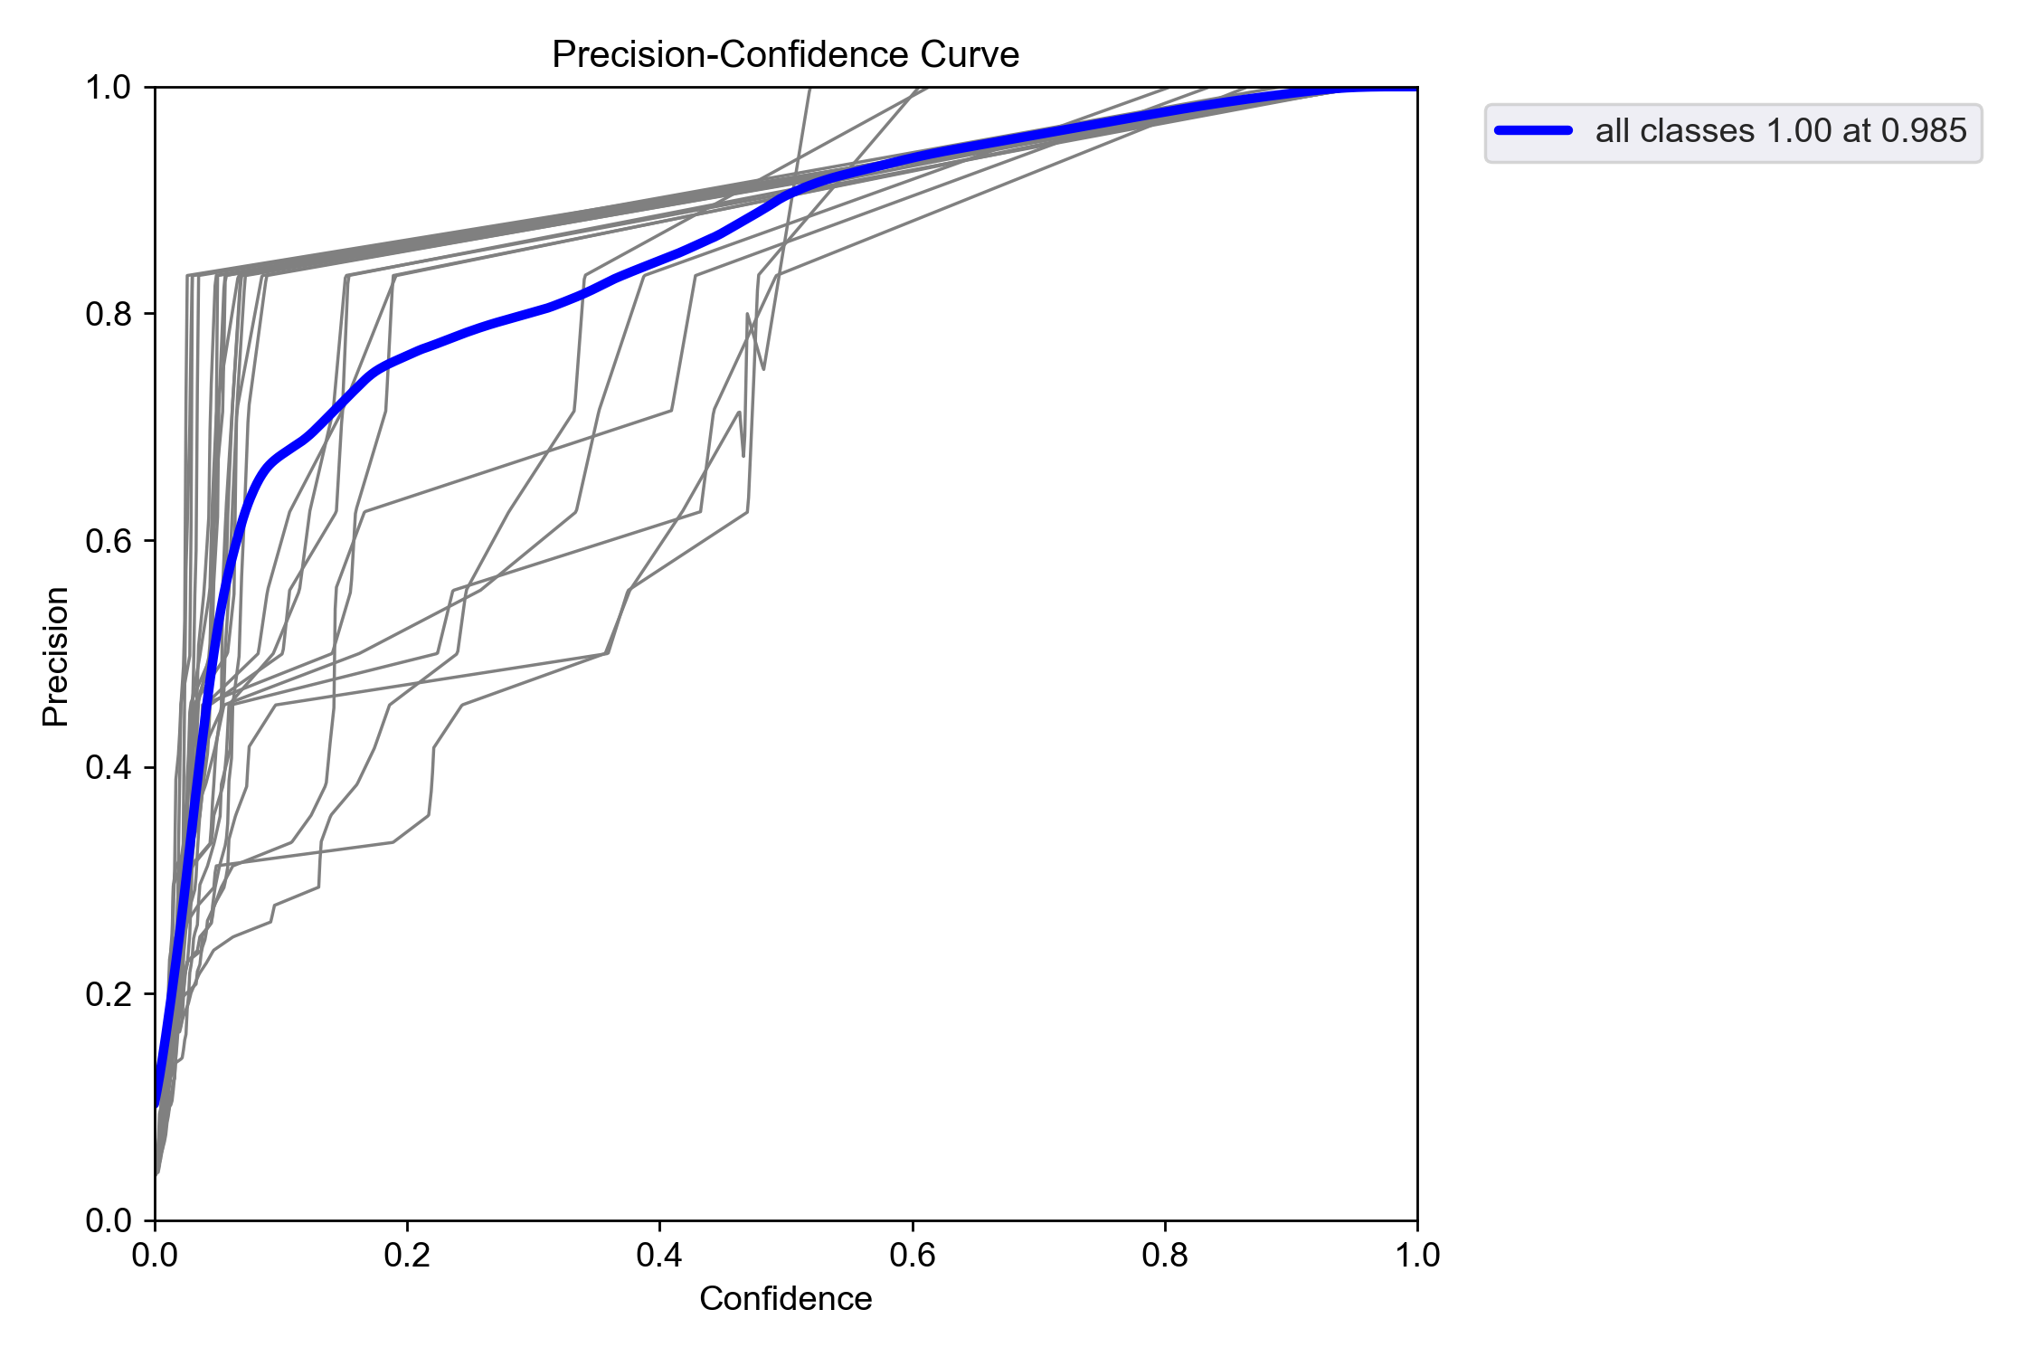
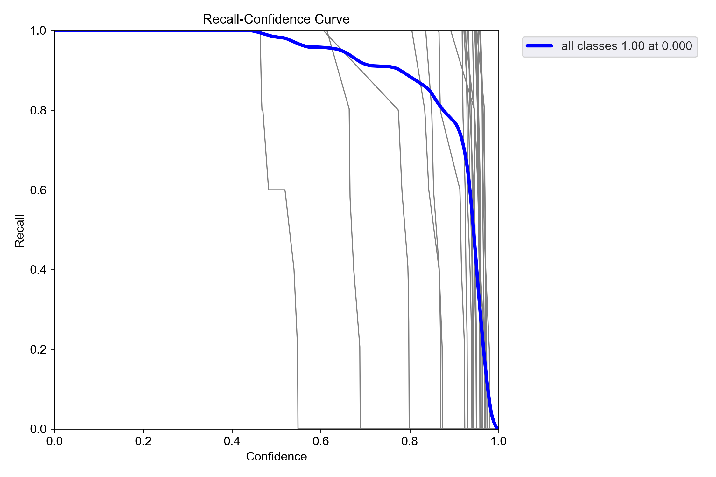
Validate & metrics

Slide 16
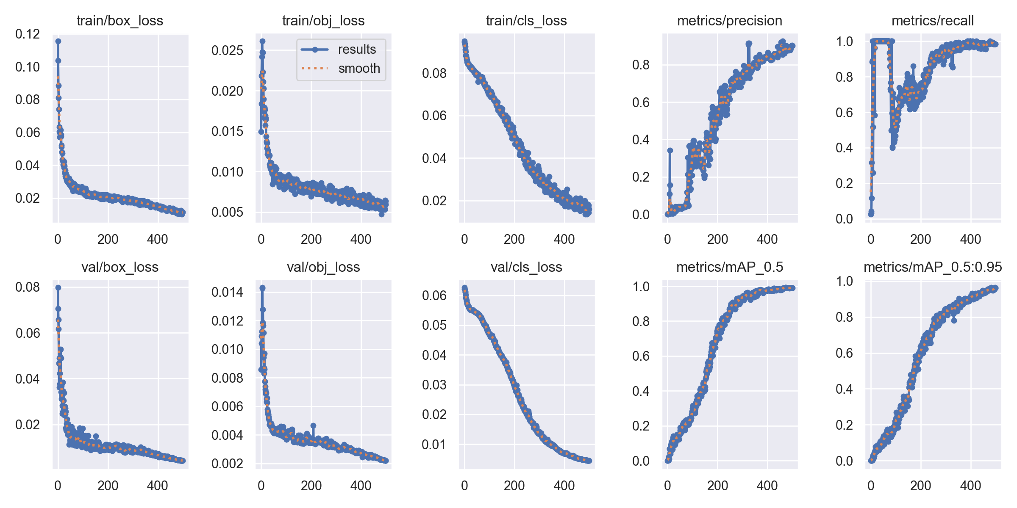
Validate & metrics

Slide 17
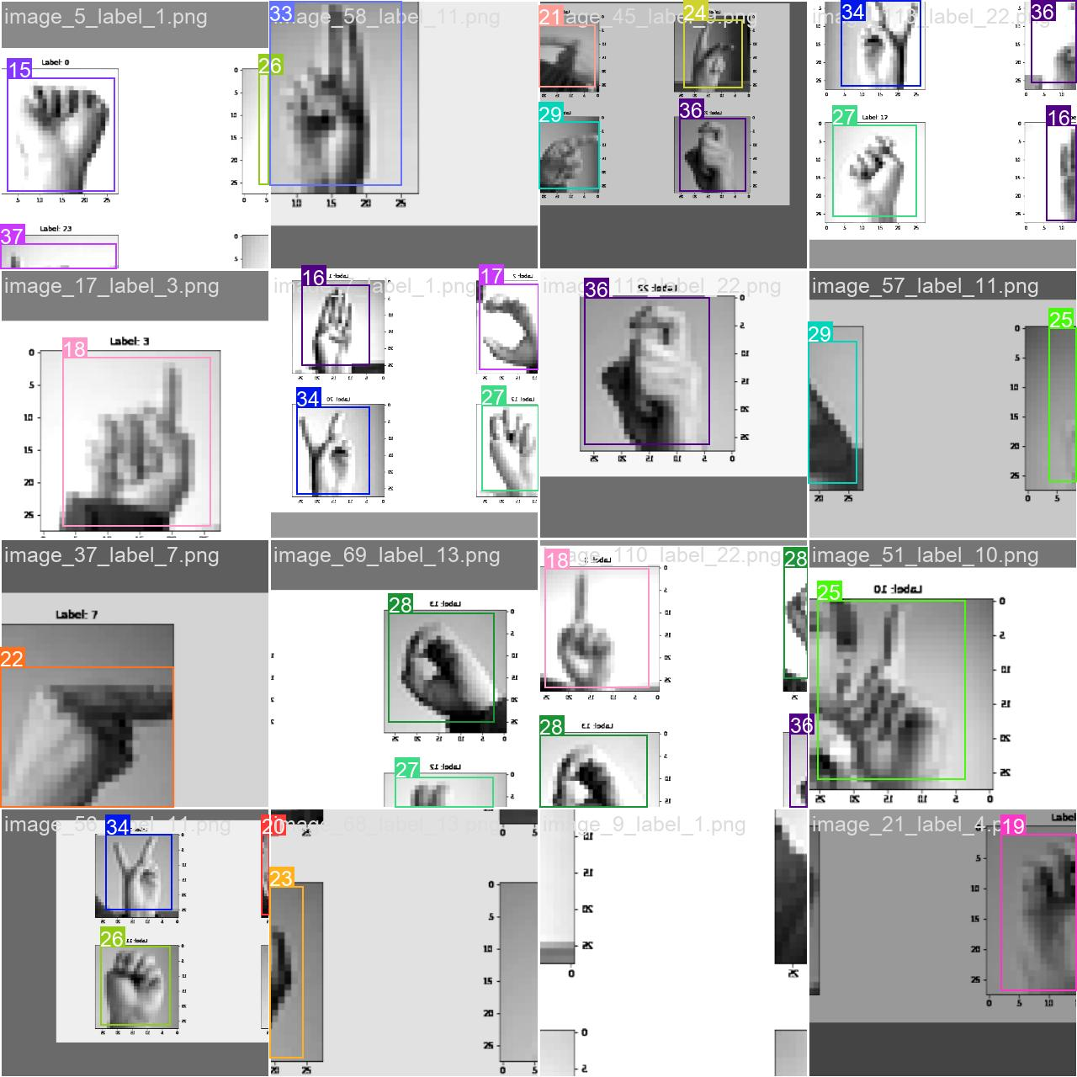
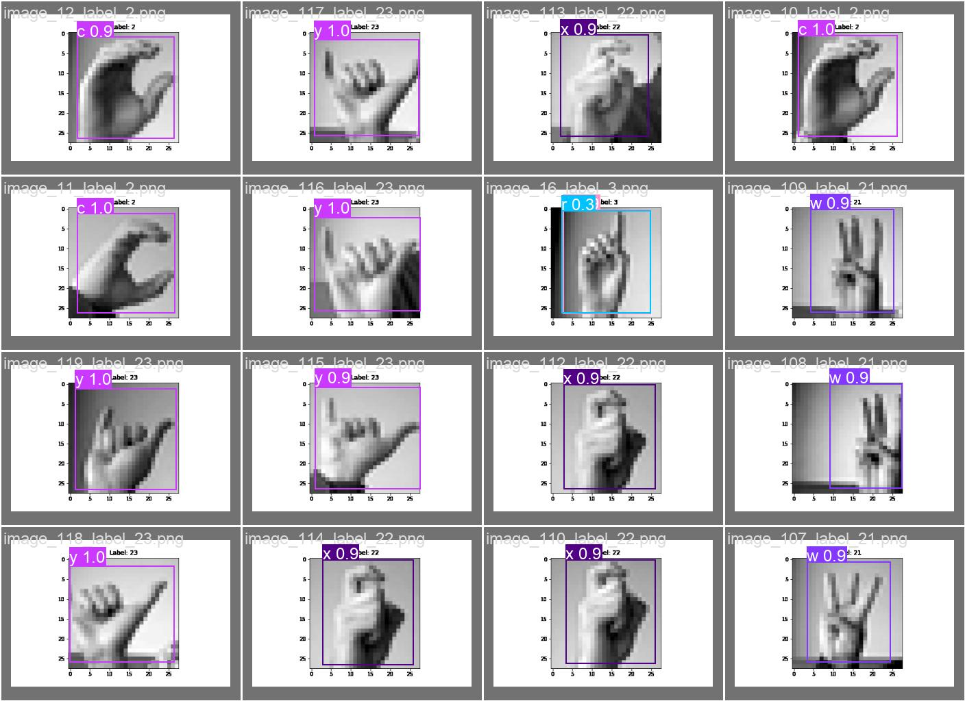
Validate & metrics

Slide 18
06
Third model
The convolutional neural network CNN

Slide 19
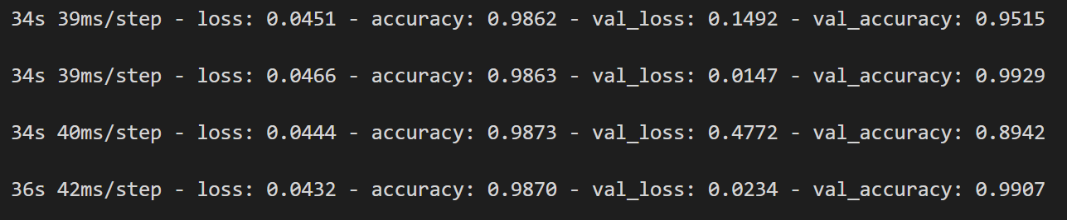
The convolutional neuron network CNN
Convolutional Neural Networks (CNNs):
CNNs are a class of deep neural networks specifically designed for processing
and analyzing visual data. They are particularly powerful in tasks such as
image recognition and object detection. CNNs leverage convolutional layers to
automatically and adaptively learn spatial hierarchies of features from input
images.
We also used data augmentation to enhance the model even more
Metrices:

Slide 20
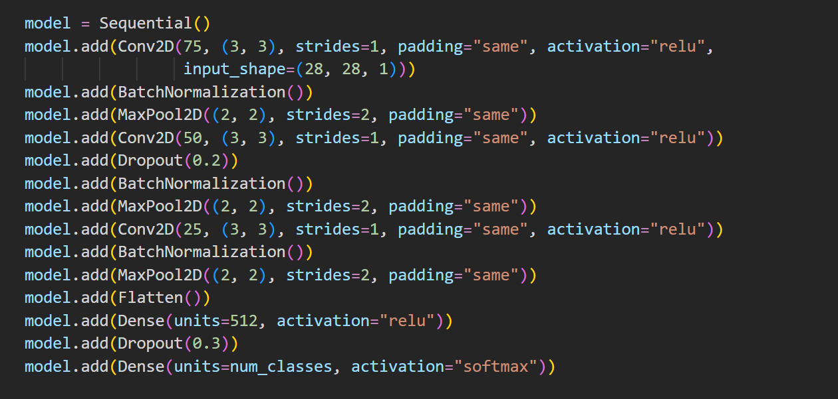
The convolutional neuron network CNN
Architecture Design:

Slide 21
07
Comparing the results

Slide 22
Predicted Results Accuracy:
78.61%
98.8%
90%
SVM
CNN
YOLOv5

Slide 23
Comparison
 | SVM | CNN | YOLOv5
Accuracy | 78.61 | 98.8 | 90
Val_loss | - | 0.0234 | 0.0044
epochs | - | 20 | 500

Slide 24
Thank you
Dr. Wael Badawy
Eng. Aya Adel

